Slide 1
SUPERSTORE
MARKETING
CAMPAIGN
ANALYSIS
DATA ANALYTICS
BATCH-1014

Slide 2
Superstore Marketing Campaign Analysis
Predicting Gold Membership Acceptance &
Optimising Marketing Strategy
Presented by: Dipanshu Sheshkumar Rangari
Course: Data Analytics with GenAI
Batch:1014
Institution: Career247

Slide 3
Business Context
- Superstore runs an annual year-end promotional
campaign inviting existing customers to purchase
a Gold Membership
- Gold Membership offers a 20% discount on
all purchases
- Dataset contains 2,213 customers across 22 features
including demographics, spending behavior,
channel usage and recency
- Target Variable: Response
1 = Customer Accepted the Membership
0 = Customer Declined the Membership
- Overall Membership Acceptance Rate: 15.05%

Slide 4
Project Phases & Stages
Phase 1: Business Understanding & KPI Framework
Phase 2: Data Validation & Quality Check (Excel)
Phase 3: Python Integration & Data Connectivity
Phase 4: Data Cleaning, Feature Engineering & Exploratory Data Analysis (EDA)
Phase 5: Statistical Analysis & Predictive Modeling
Phase 6: Interactive Dashboard Development (Power BI)
Phase 7: Strategic Insights, Business Recommendations & Final Reporting

Slide 5
Techniques, Methodologies & Tools Used​
Tools :
Techniques & Methodologies​ :
Statistical Testing — T-tests, Chi-Square Tests & ANOVA for Data Insights​
Logistic Regression — Baseline Predictive Model Development​
Random Forest — Primary Machine Learning Model for Prediction​
SMOTE — Handling Class Imbalance & Improving Model Performance
Excel — Data Validation, Cleaning & Integrity Checks
Python — Data Cleaning, EDA, Feature Engineering & Machine Learning
Power BI — Interactive Dashboards, Visualization & KPI Reporting

Slide 6
Dataset Overview & Key Performance Indicators
Key KPIs:
- Membership Acceptance Rate: 15.05%
- Average Customer Income: $52,247
- Average Total Spend (2 years): $607.02
- Average Recency: 49.1 days
- Top Spending Category: Wine ($305.15)
- Most Used Channel: In-Store (39%)
- Complaint Rate: 1.06%
Dataset Overview:
- Total Customers: 2,213
- Total Features: 22
- Target Variable: Response (1 = Accepted, 0 = Declined)
- Data Includes: Demographics, Spending Behavior,
Channel Usage and Recency

Slide 7
Customer Segmentation Findings
Demographic Profile of Our Customers:
Average Age: 57 years (Range: 30 – 86)
- Dominant Education: Graduation (50.4%),
Master (25.5%), PhD (21.7%)
- Dominant Marital Status: Married (38.7%),
Together (25.8%), Single (21.5%)
- Average Family Size: 1 (Kids + Teens combined)
Key Segmentation Findings:
- Income: Responders earn $9,386 more than
Non-Responders ($60,210 vs $50,824) ✅ Significant
- Education: Higher education levels show greater
membership acceptance ✅ Significant
- Marital Status: Single & Divorced customers show
higher acceptance rates ✅ Significant
- Age: No significant difference between
Responders and Non-Responders ❌ Not Significant
- Family Size: Smaller households respond better
to the membership offer ✅ Significant

Slide 8
Customer Spending Behavior
Key Insight:
- Responders spend nearly 2x more across
every product category
- Wine and Meat show the largest gaps —
strongest indicators of membership acceptance
- Most customers buy across all 6 categories
(Median Category Breadth = 6/6)
Overall Spending Pattern:
- Average Total Spend: $607.02
- Median Total Spend: $396.50
- Most customers spend below $400 —
a small group of high spenders pulls the average up
Spending by Product Category:
Category | Responders | Non-Responders
Wine | $502.62 | $270.18
Meat | $293.77 | $144.50
Gold Products | $61.25 | $40.84
Fish | $51.71 | $35.14
Sweets | $38.37 | $25.03
Fruits | $37.94 | $24.27

Slide 9
Channel Performance Analysis
Overall Channel Usage:
Channel Share of Purchases
In-Store 39.0%
Web 27.5%
Catalogue 17.9%
Deals/Discounts 15.6%
Key Insights:
- Catalogue is the biggest differentiator —
Responders use it 75% more than Non-Responders
- Web purchases show a meaningful gap —
digitally active customers are more receptive
- Deals and Web Visits show virtually no difference —
discount hunters are not the membership audience
- In-Store dominates overall but doesn't
strongly predict acceptance
Channel Usage — Responders vs Non-Responders:
Channel | Responders | Non-Responders
Web | 5.07 | 3.91
Catalogue | 4.20 | 2.40
In-Store | 6.08 | 5.76
Deals | 2.34 | 2.32

Slide 10
Key Statistical Findings
T-Tests — Comparing Responders vs Non-Responders:
Variable | Responders | Non-Responders | Result
Income | $60,210 | $50,824 | ✅ Significant
Total Spend | $985.66 | $539.95 | ✅ Significant
Recency | 35.26 days | 51.44 days | ✅ Significant
Age | 56.50 years | 57.19 years | ❌ Not Significant
Key Takeaway:
- Income, Total Spend and Recency are the
strongest numerical predictors of acceptance
- Education and Marital Status significantly
influence membership response
- Age has no statistical impact on acceptance
Variable | Chi-Square | p-value | Result
Marital Status | 51.14 | 0.0000 | ✅ Significant
Education | 21.33 | 0.0001 | ✅ Significant
Chi-Square Tests — Categorical Variables
Test | Result
Total Spend by Education | ✅ Significant (F = 16.92)
Income by Marital Status | ❌ Not Significant
ANOVA Tests

Slide 11
Predictive Modelling — Model Comparison
Approach:
- Target Variable: Response (1 = Accepted, 0 = Declined)
- Challenge: Class Imbalance — 1,880 Non-Responders
vs only 333 Responders (85:15 ratio)
- Solution: Applied SMOTE (Synthetic Minority
Oversampling Technique) to balance training data
- Three models built and compared:
Why RF + SMOTE?
- Catches 32 out of 67 actual responders —
more than double the original Random Forest
- In marketing, missing a genuine prospect is
far more costly than a false alarm
- Recall improved from 22% to 48% —
the metric that matters most for campaigns
Model Comparison:
Metric | Logistic Regression | Random Forest | RF + SMOTE ✅ Recommended
Accuracy | 86% | 86% | 84%
Precision | 63% | 65% | 47%
Recall | 18% | 22% | 48%
F1 Score | 0.28 | 0.33 | 0.47
ROC-AUC | 0.80 | 0.84 | 0.83
Responders Correctly Caught | ~12 | 15 | 32

Slide 12
Predictive Modelling — The Challenge
Objective:
Predict which customers will accept
the Gold Membership before the campaign launches
The Problem — Class Imbalance:
1,880 customers declined (85%)
Only 333 customers accepted (15%)
- A model predicting "No" for everyone
achieves 85% accuracy — but is completely useless
The Solution — SMOTE:
- SMOTE (Synthetic Minority Oversampling Technique)
artificially balances the training data
- Forces the model to learn patterns of
both Responders and Non-Responders equally
- Result: Model becomes significantly better
at identifying actual responders

Slide 13
What Drives Membership Acceptance?
Top Predictors from Random Forest + SMOTE Model:
Rank | Feature | Business Interpretation
🥇 1 | Recency | Customers who purchased recently are much more likely to accept the offer.
🥈 2 | Web/Store Ratio | Digitally engaged customers respond better to marketing campaigns.
🥉 3 | Total Spend | High-spending customers perceive greater value from discounts and memberships.
4 | Income | Higher-income customers are more comfortable with membership costs.
5 | Tenure Days | Long-standing customers tend to be more loyal and receptive to offers.
6 | Family Size | Smaller households show a higher likelihood of responding.
7 | Store Purchases | Frequent in-store shoppers are highly engaged customers.
Insight | Implication
🎯 Recency is the strongest predictor | Launch campaigns soon after a customer's purchase to maximize conversion.
💰 Spending behavior matters | Prioritize high-value customers for membership offers.
📱 Channel engagement is critical | Customers active on digital channels are more responsive to promotions.
👥 Behavior outweighs demographics | Purchase history and engagement patterns are stronger predictors than age or education.

Slide 14
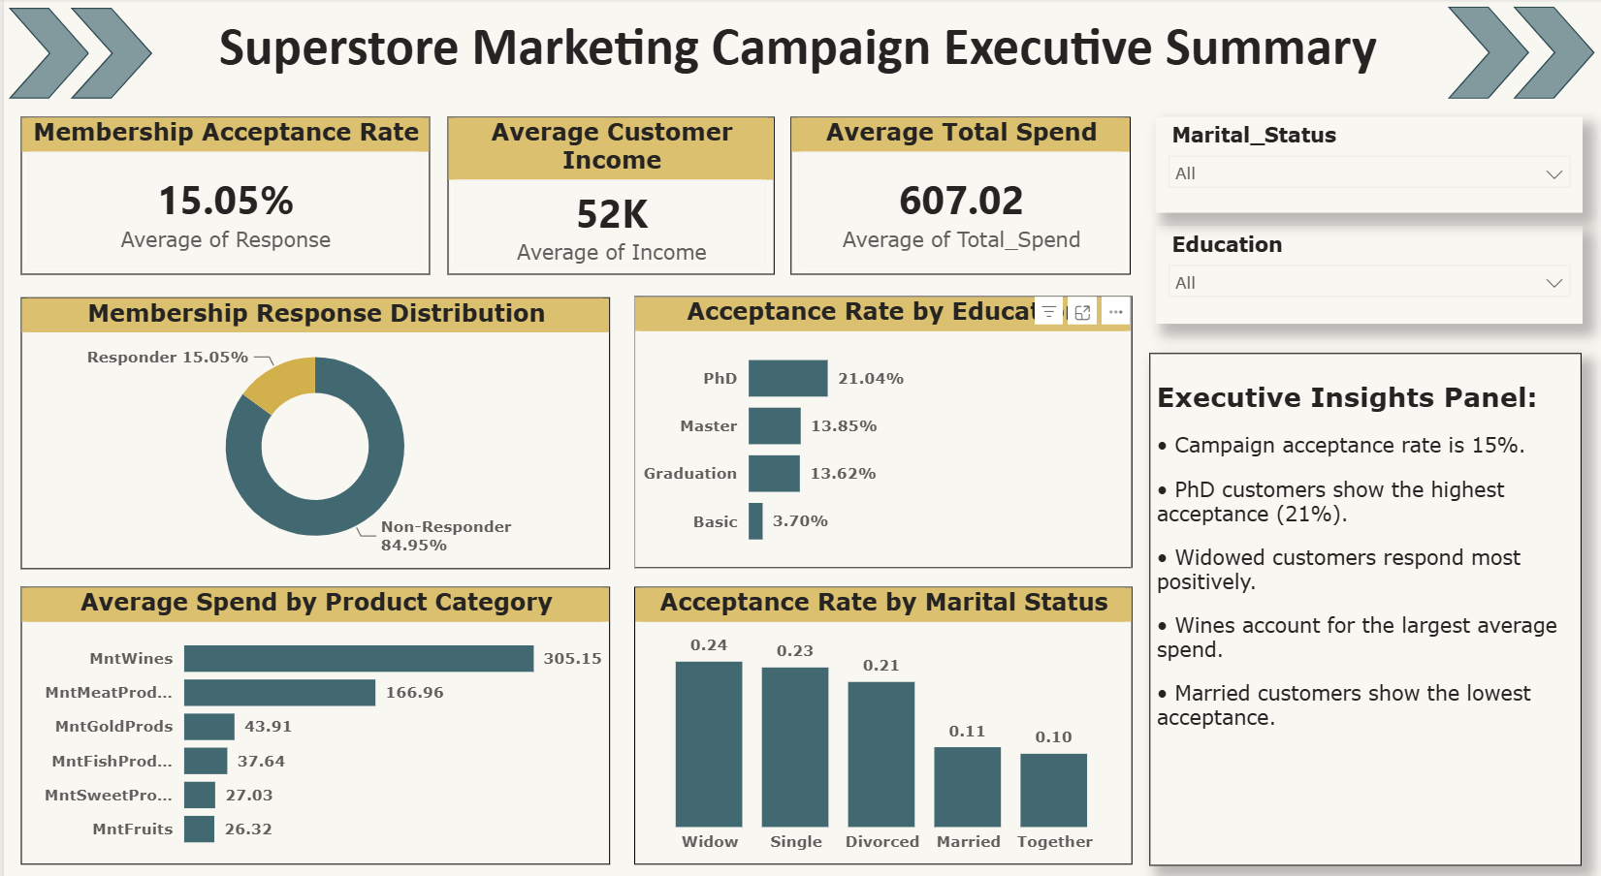
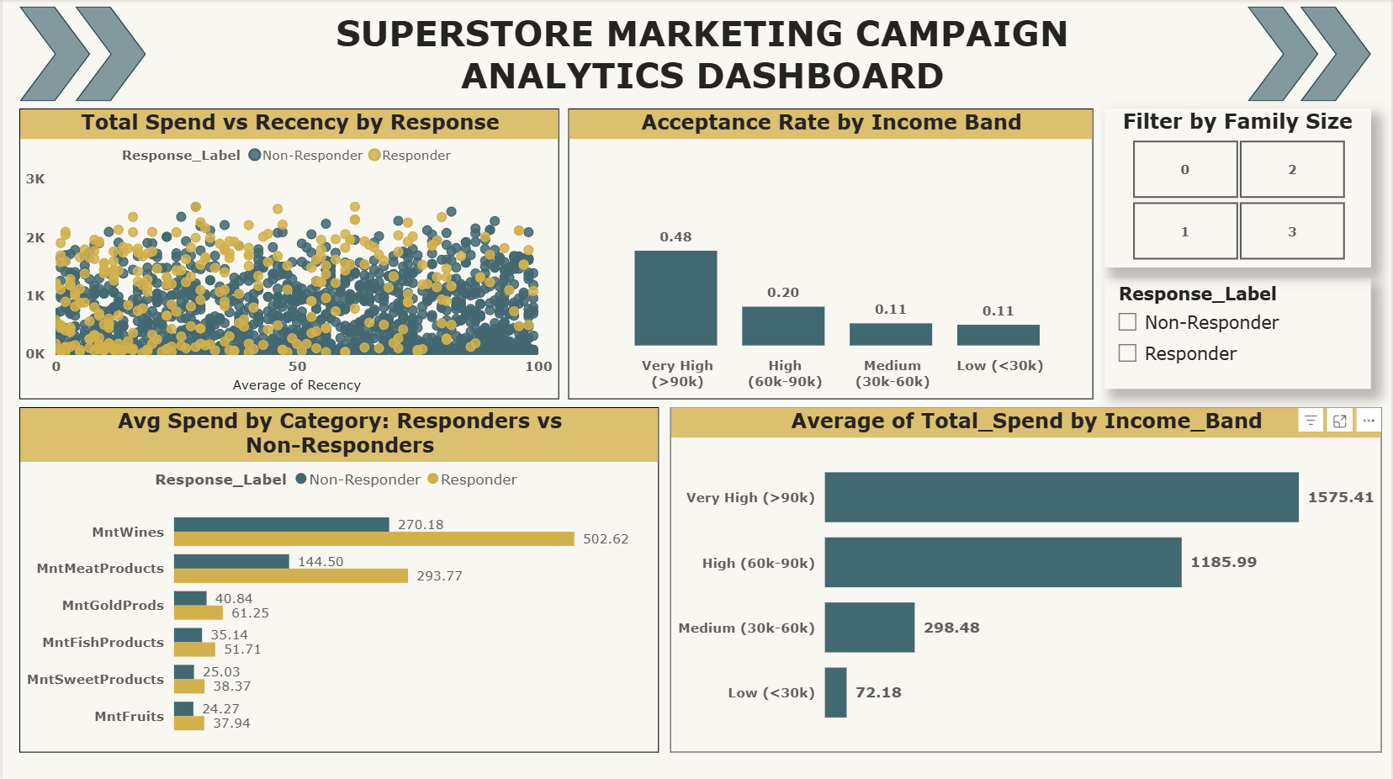
Performance Dashboards — Power BI
Two Interactive Dashboards Built in Power BI
Executive Dashboard:
Marketing Dashboard:

Slide 15
Sr. | Recommendation | Action
✅ 1 | Target High-Income, High-Spend Customers First | Prioritize customers with Income > $55,000 and Total Spend > $400 to maximize campaign ROI.
✅ 2 | Lead With Catalogue & Web Channels | Focus on Catalogue and Web users; reduce investment in the Deals channel where response rates are lower.
✅ 3 | Time Campaigns Around Recent Purchases | Target customers within 30 days of their last purchase, when engagement and conversion likelihood are highest.
✅ 4 | Re-engage Dormant Customers Separately | Customers inactive for 60+ days should receive re-engagement campaigns before membership offers.
✅ 5 | Rethink the Offer for Family Households | Introduce family-focused benefits or deprioritize this segment due to lower response rates.
✅ 6 | Use Predictive Scoring for Campaign Targeting | Apply the RF + SMOTE model and focus outreach on the top 20–30% predicted responders.
Strategic Recommendations
Executive Takeaway
Focus on recent, high-value customers through Catalogue and Web channels, and use predictive scoring to concentrate marketing efforts on the customers most likely to respond.

Slide 16
Conclusion & Next Steps
Key Takeaways:
- Only 15.05% of customers accepted the membership
so there is significant room for improvement
- Top 3 drivers of acceptance:
Recency (shop within last 35 days)
Total Spend (high spenders see more value)
Income (higher income = more receptive)
- RF + SMOTE model achieves ROC-AUC of 0.83
and correctly identifies 48% of real responders
- Catalogue and Web are the most effective
channels for membership campaigns
Next Steps:
Deploy predictive model to score customers before next campaign launch
- A/B test catalogue vs web campaign
to measure channel effectiveness.
- Collect richer data — browsing history,
past campaign responses — to improve model.
- Redesign membership benefits for
family households.
- Retrain model after each campaign
with new response data

Slide 17
THANK YOU!!
THANK YOU!!

